Slide 1
X-ray diffraction at extreme conditions: tools and practice
Introduction

Slide 2
Extreme conditions?
An extreme environment contains conditions that are hard to survive for most known life forms (Wikipedia.org)
..research in nuclear physics relates to the study of nuclei under extreme conditions such as high spin and excitation energy.. (Wikipedia.org)

Slide 3
Extreme conditions
Extreme conditions are conditions expanding the current thermodynamic state beyond the limits of the ambient.
P-V-T-H-E-t-.. phase diagram
P | Pressure
V | Volume
T | Temperature
H | Magnetic Field
E | Electrical Field
t | Time

Slide 4
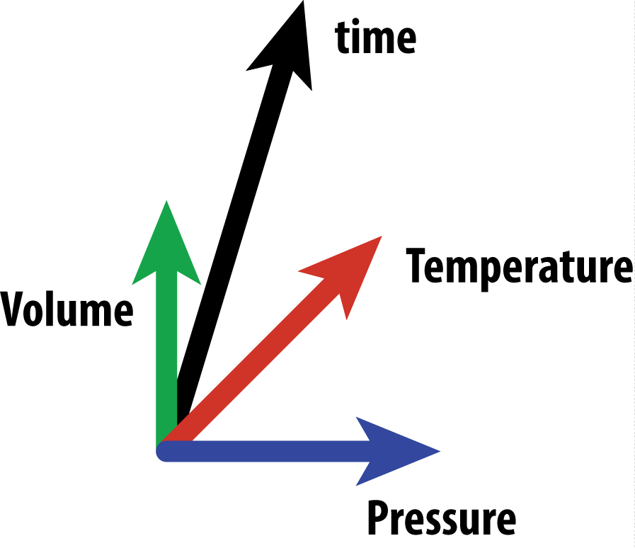
Extreme high pressure P-V-T-t
specific states of matter
phase equilibria
fundamental materials
applied materials

Slide 5
Extreme high pressure P-V-T-t
P-T (no chemistry):
clean adjustment
no doping
P-T (chemistry):
new bonding
new materials

Slide 6
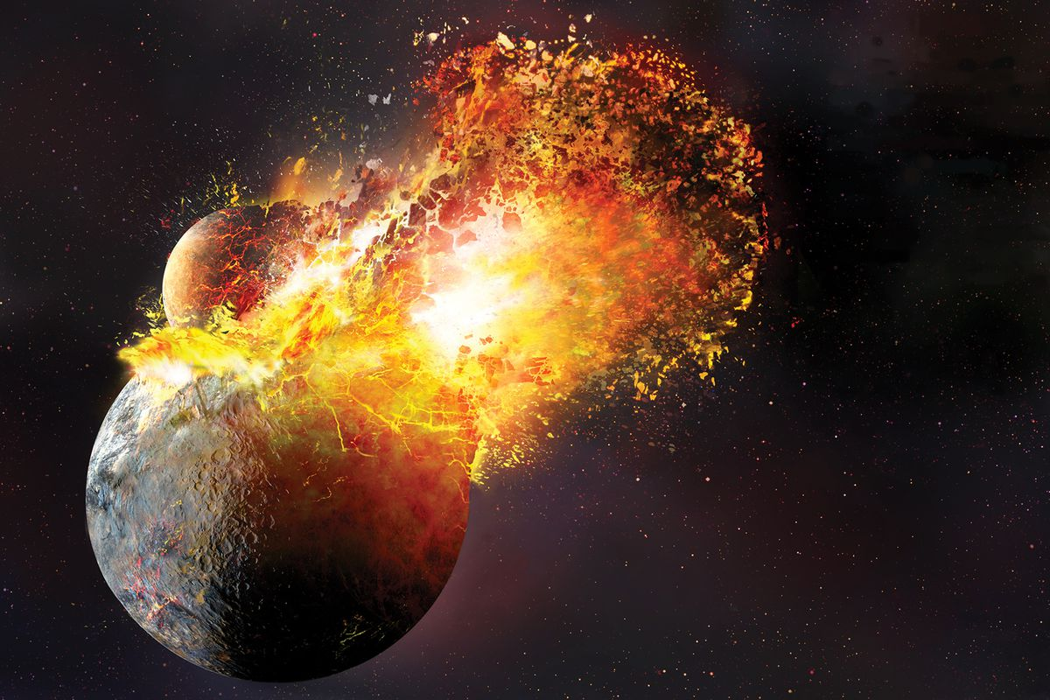
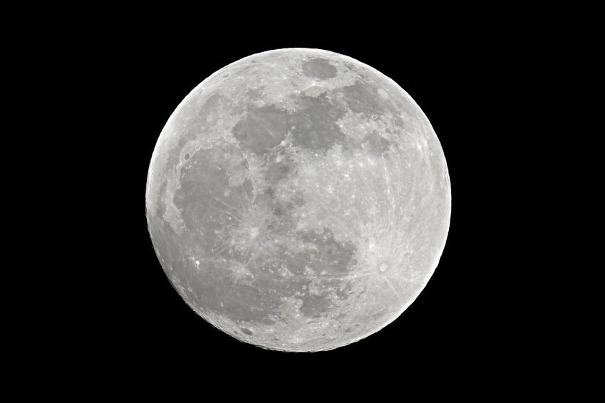

P-t conditions
dynamic
static

Slide 7

Field practice

Slide 8

Know-how..

Slide 9

Know-how..

Slide 10
Course outline
Lectures
Seminars
Understand your experiment
Preparation for HP experiment:
X-ray source
Calibration
Sample environment
Data simulation
Detectors
Data processing:
Understand your signal
Processing powder
Understand your pressure
Processing single crystal

Slide 11
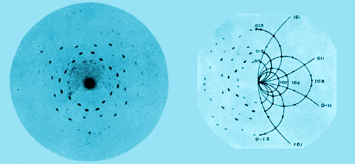

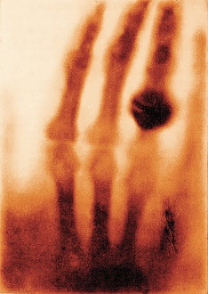
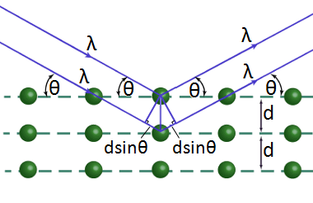
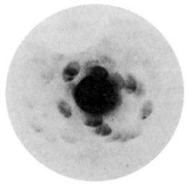
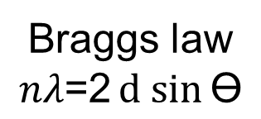
History of the X-rays
W. H. Bragg
W. L. Bragg
X-rays in techniques used for structure determination of small and large molecules; crystalline, amorphous and nano-scale materials (diffraction).
Chemistry characterization (electron and nuclear based spectrometry such as fluorescence and etc.)
Etc. etc. etc.
W. C. Röntgen
M. von Laue
1895
1912
Discovery
of the X-rays
Penetrating radiation
X-rays as waves produce
interference patterns.
Detected intensities correspond to diffraction
of planes with specific atomic arrangement.
Bragg’s law
Braggs law
$$nλ\text{=2}d sin{\text{ϴ}}$$
Images – courtesy of the internet

Slide 12
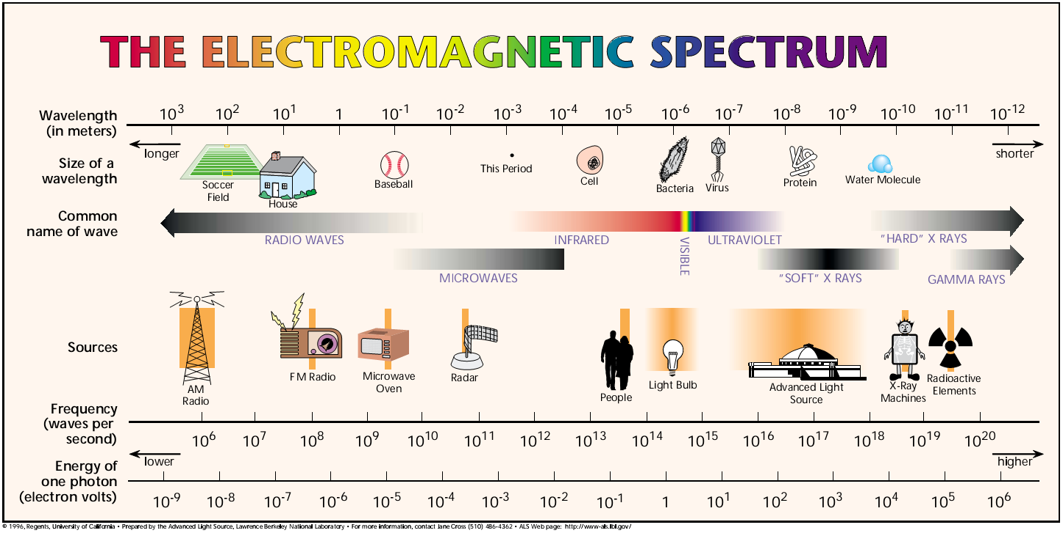
EM spectrum + X-rays
courtesy of Advanced Light Source

Slide 13

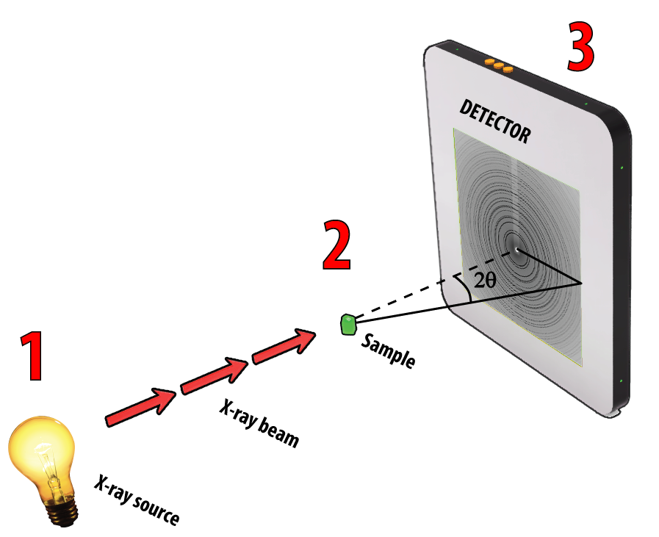
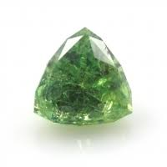
Source
Collimation
Focusing
Sample
Detector

Slide 14
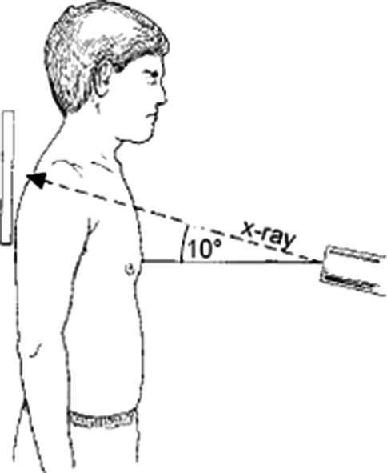
X-rays sources
X-ray Sources and capabilities
In general and for extreme conditions
WTF!?
MoKα?
Oldies
Newbies
Notes:
You may find some annoying specimens around
Like the specimens -

Slide 15
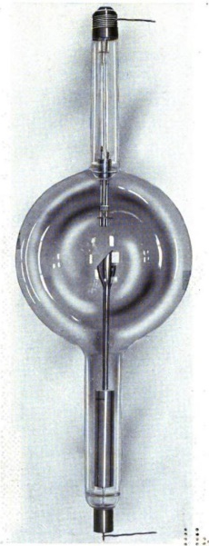
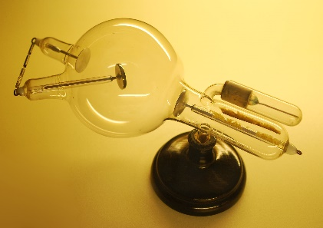
Lab. X-ray sources
Crookes tube from
W. C. Röntgen museum
1870
1913
1917
W. Crookes
‘cold tubes’
W. Coolidge
fixed anode
Notes:
William Crookes
Cold emission – DC voltage 100kV cathode -0 right and anode center+left. Low pressure 10-6-10^-8 atm. Gas atom ionized – positive ions – go to the cathode, create more electrons. High speed electron go for anode and produces bremsstrahlung + characteristic lines.
William Coolidge

Slide 16
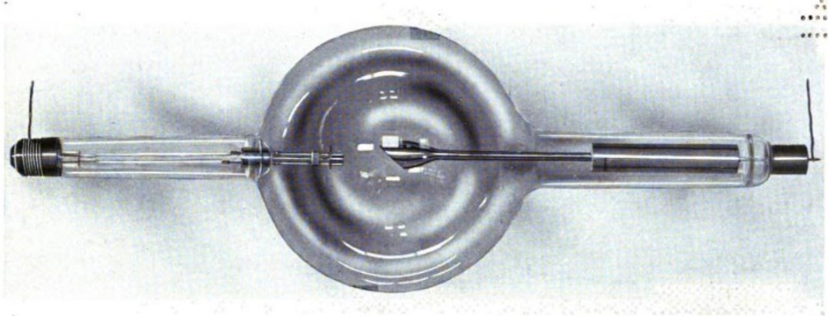
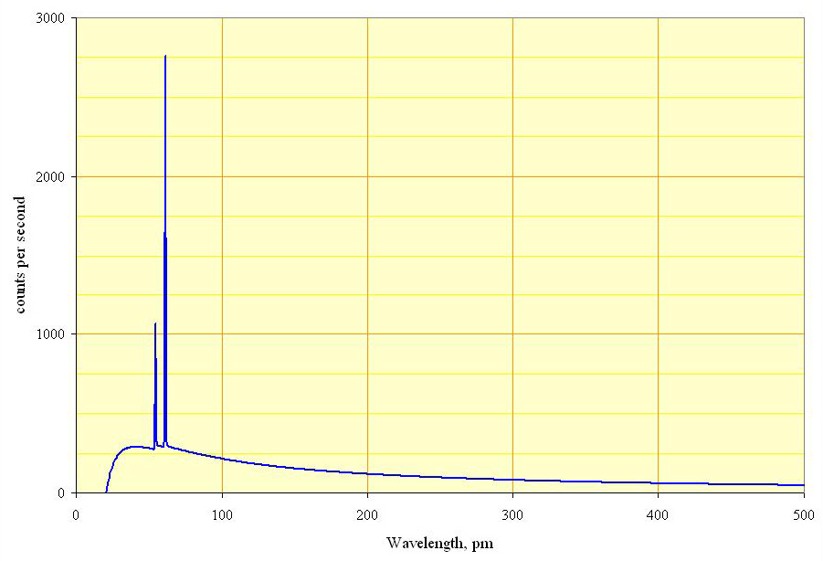
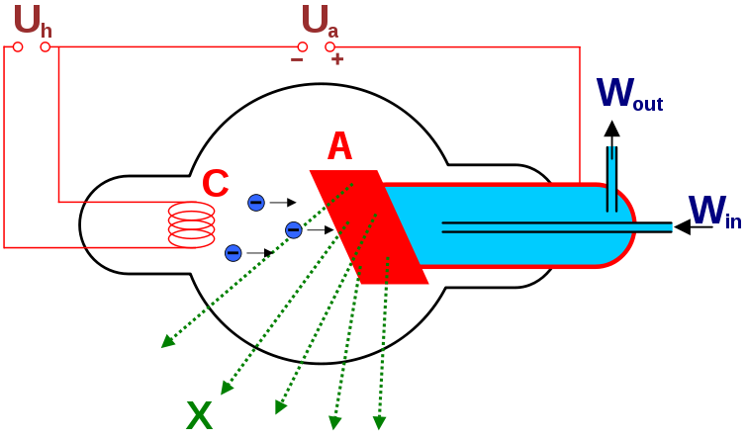
Lab. X-ray source: W. Coolidge tube
Rhodium target
Characteristic X-rays
K_{α1} (20.2keV, 0.61A) K_{β1} (22.7keV, 0.54A)
bremsstrahlung
Cathode
i.e. tungsten
Anode
Materials producing
char. X-rays.
Notes:
The bremsstrahlung or free - free emission mechanism is an example of a radiative process of considerable interest in modern astrophysics. This mechanism involves the emission of a photon by an electron due to an electrostatic interaction with another charged particle. In other words, when an electrons path is deviated by a charged atomic nucleus it can emit or absorb a photon
Compton is a mechanism of scattering

Slide 17
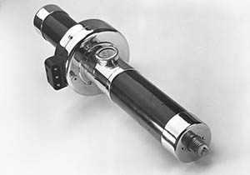
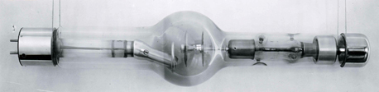
Lab. X-ray sources
Crookes tube from
W. C. Röntgen museum
Siemens produces
`Pantix`
1870
1913
1917
1929
1934
W. Crookes
‘cold tubes’
W. Coolidge
fixed anode
Philips produces
First rotating anode
‘Rotalix’
idea or. from 1897
Notes:
William Crookes
Cold emission – DC voltage 100kV cathode -0 right and anode center+left. Low pressure 10-6-10^-8 atm. Gas atom ionized – positive ions – go to the cathode, create more electrons. High speed electron go for anode and produces bremsstrahlung + characteristic lines.
William Coolidge

Slide 18
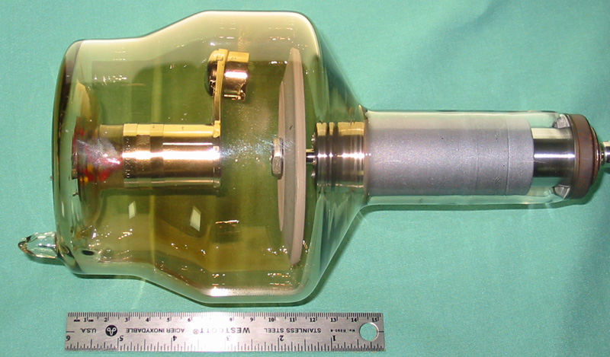
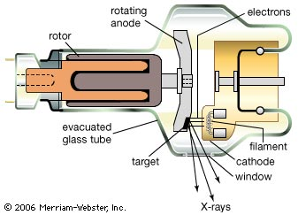
X-ray source: Rotating anode
Rotating
anode
Tapered
anode
X-rays
Simple tube

Slide 19
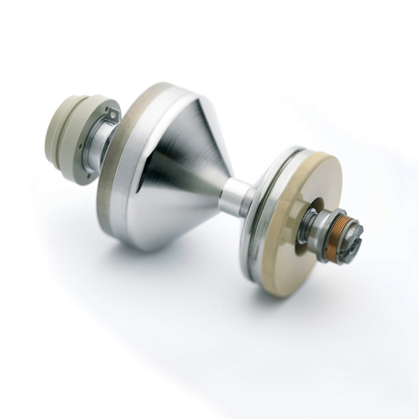
Lab. X-ray sources
Made in Germany
Siemens produces
`Pantix`
1929
1934
2005
Liquid metal
sources
Fancy anode
Anode – fixed,
Tube is rotating
Philips produces
First rotating anode
‘Rotalix’
idea or. from 1897
Notes:
William Crookes
Cold emission – DC voltage 100kV cathode -0 right and anode center+left. Low pressure 10-6-10^-8 atm. Gas atom ionized – positive ions – go to the cathode, create more electrons. High speed electron go for anode and produces bremsstrahlung + characteristic lines.
William Coolidge

Slide 20
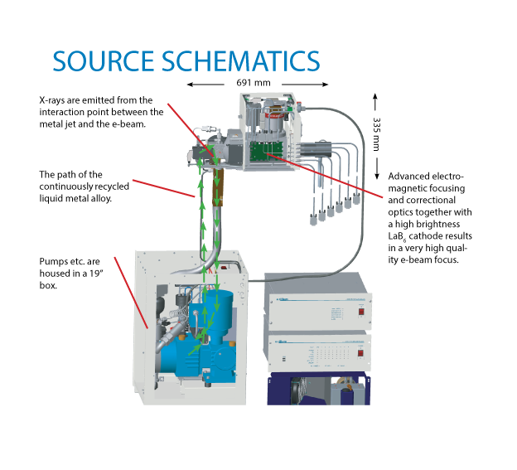
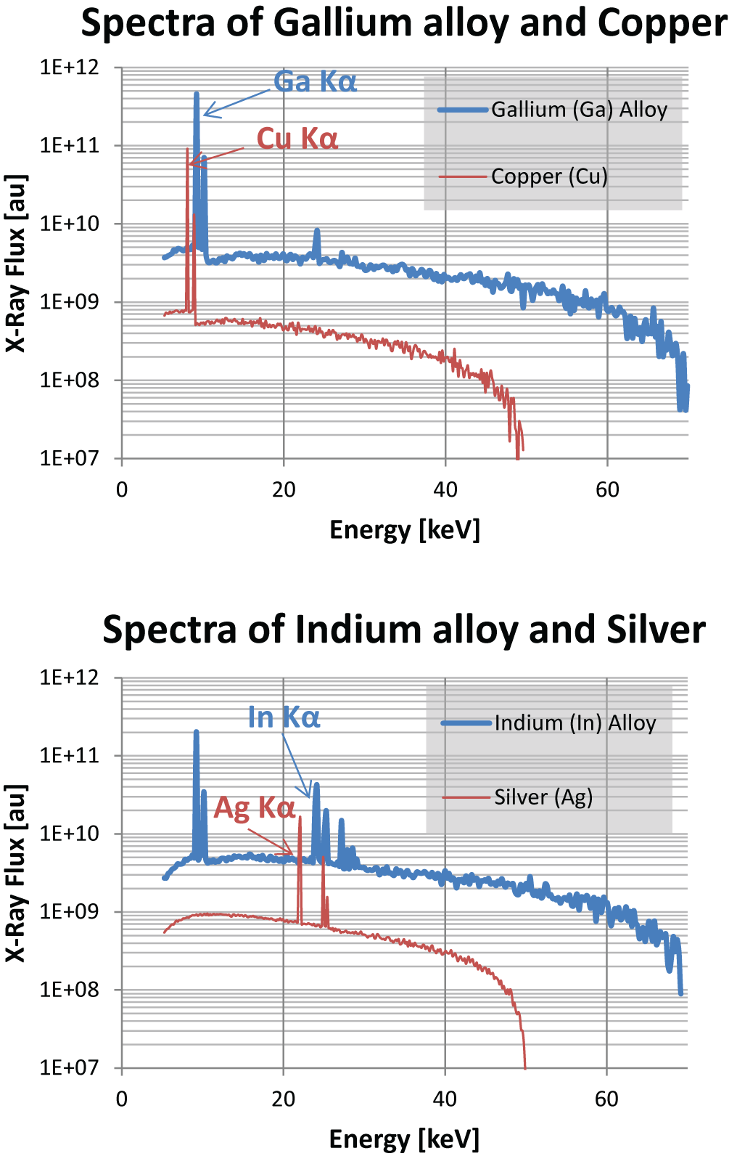
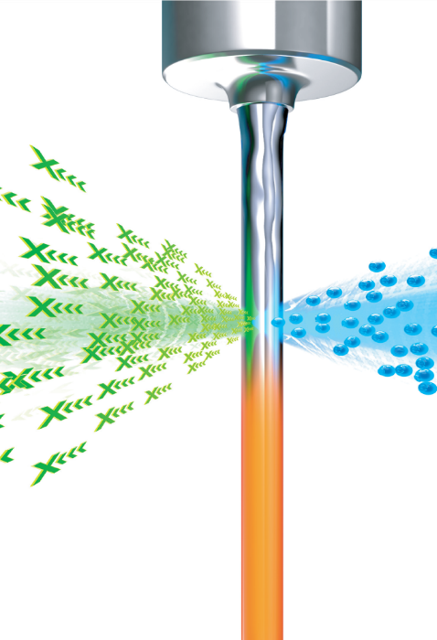
Lab. X-ray sources: Liquid metal
K_{α1}: Ga – 9keV (1.35Å); In – 24.2keV (0.51Å);
Notes:
William Crookes
Cold emission – DC voltage 100kV cathode -0 right and anode center+left. Low pressure 10-6-10^-8 atm. Gas atom ionized – positive ions – go to the cathode, create more electrons. High speed electron go for anode and produces bremsstrahlung + characteristic lines.
William Coolidge

Slide 21
Typical wavelengths for laboratory sources: how is it for the HP diffraction?
Source mat. | Wavelength, Å | Energy, keV
Cr | 2.28 | 5.415
Fe | 1.94 | 6.404
Co | 1.79 | 6.93
Cu | 1.54 | 8.048
Ga* | 1.35 | 9.252
Mo | 0.71 | 17.479
Rh | 0.61 | 20.216
Ag | 0.56 | 22.163
In* | 0.51 | 24.209
Au | 0.18 | 68.804
Useful for small HP environments (diamond anvil cell)
Large focus spot – low noise to background ratio (<100µm)
Low flux at high energy
Useless for large HP environments
* - liquid metal source

Slide 22
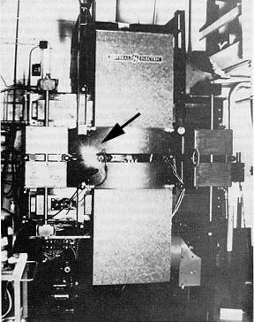
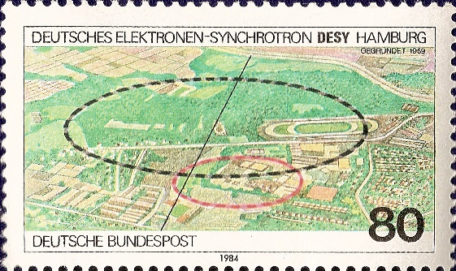
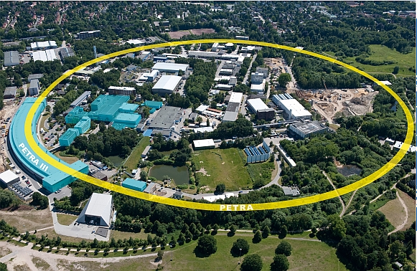
Alternative sources: synchrotron radiation X-ray sources
Synchrotron radiation is the name given to the radiation which occurs when charged particles moving at relativistic velocities are accelerated in a curved path or orbit, i.e. under influence of magnetic fields
Calculations on synchrotron radiation
Observation of
synchrotron
radiation
1944-1945
1947
1962
Present days
Ivanenko
Pomeranchuk,
USSR
Schwinger US
Rapid development of synchrotron radiation facilities
Present – 4th generation of the sources
Notes:
William Crookes
Cold emission – DC voltage 100kV cathode -0 right and anode center+left. Low pressure 10-6-10^-8 atm. Gas atom ionized – positive ions – go to the cathode, create more electrons. High speed electron go for anode and produces bremsstrahlung + characteristic lines.
William Coolidge
In – 24kEV
Observation of synchrotron radiation – by mistake

Slide 23
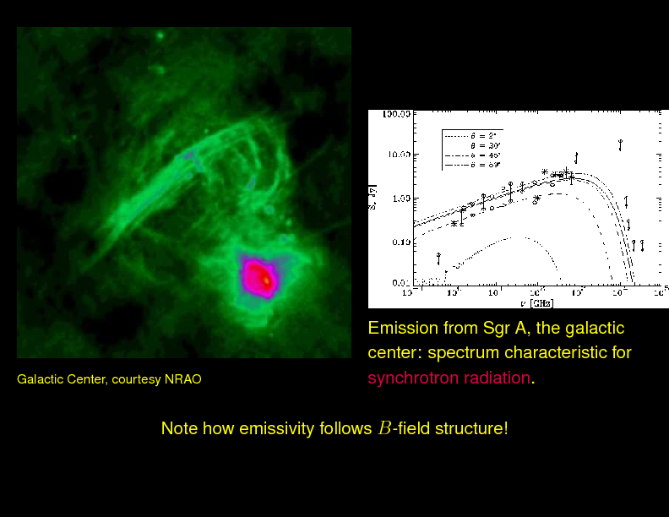
Can we find synchrotron radiation in nature?
?

Slide 24
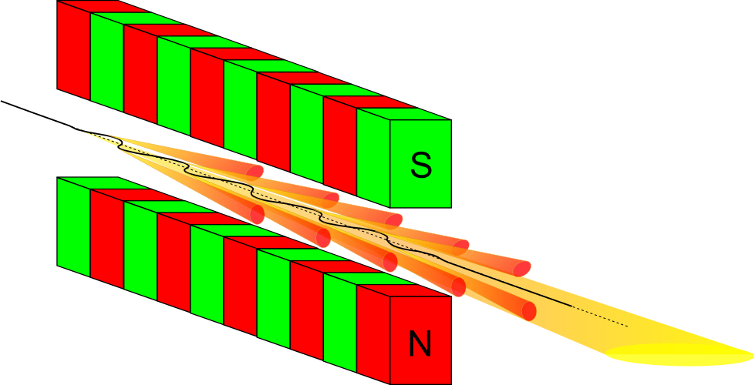
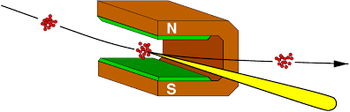
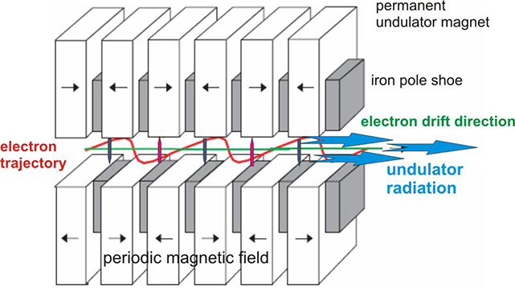
Synchrotron light source
Synchrotron radiation is the name given to the radiation which occurs when charged particles moving at relativistic velocities are accelerated in a curved path or orbit, i.e. under influence of magnetic fields
Undulator
Bending magnet
Bunch of
Electrons/positrons
X-ray radiation
cone

Slide 25
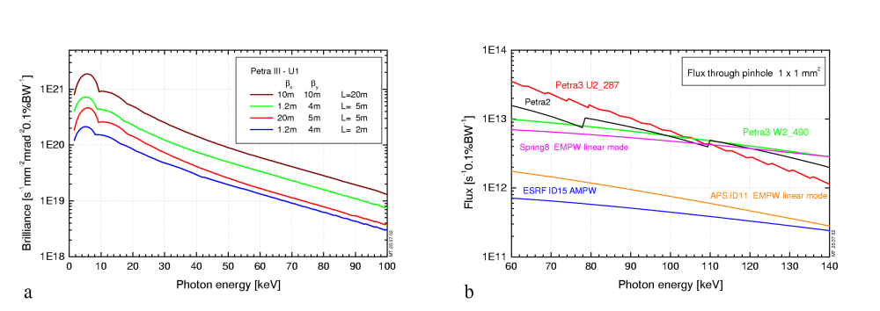
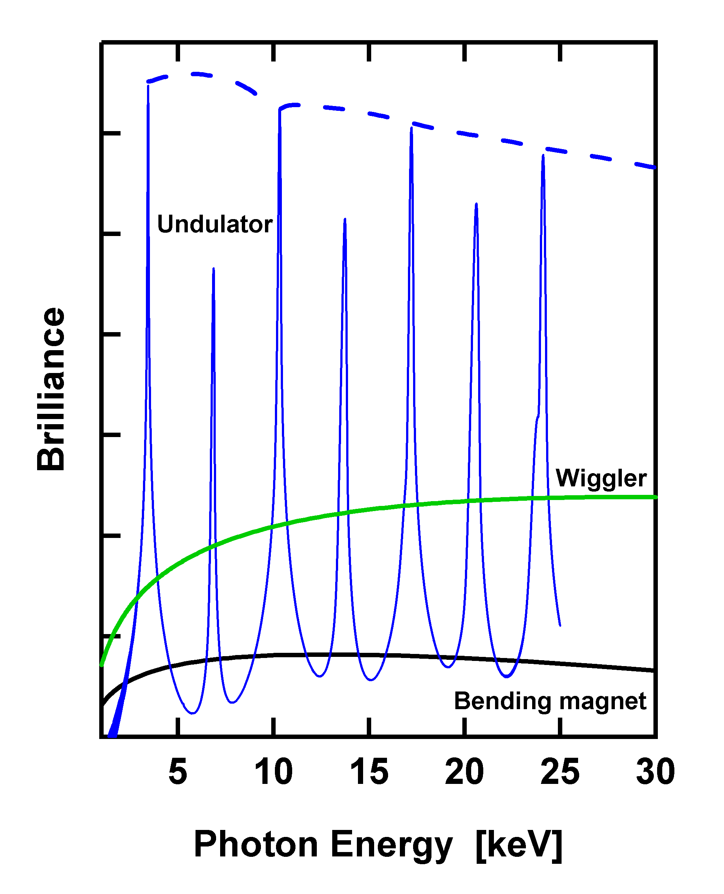
Energy bandwidth and flux of different magnetic structures
Combination of accessible energy range,
selectable energy bandwidth,
high flux and brilliance
make synchrotron sources
extremely attractive for high pressure research
Notes:
That is why most of the modern large scale synchrotron facilities have high pressure beamlines

Slide 26
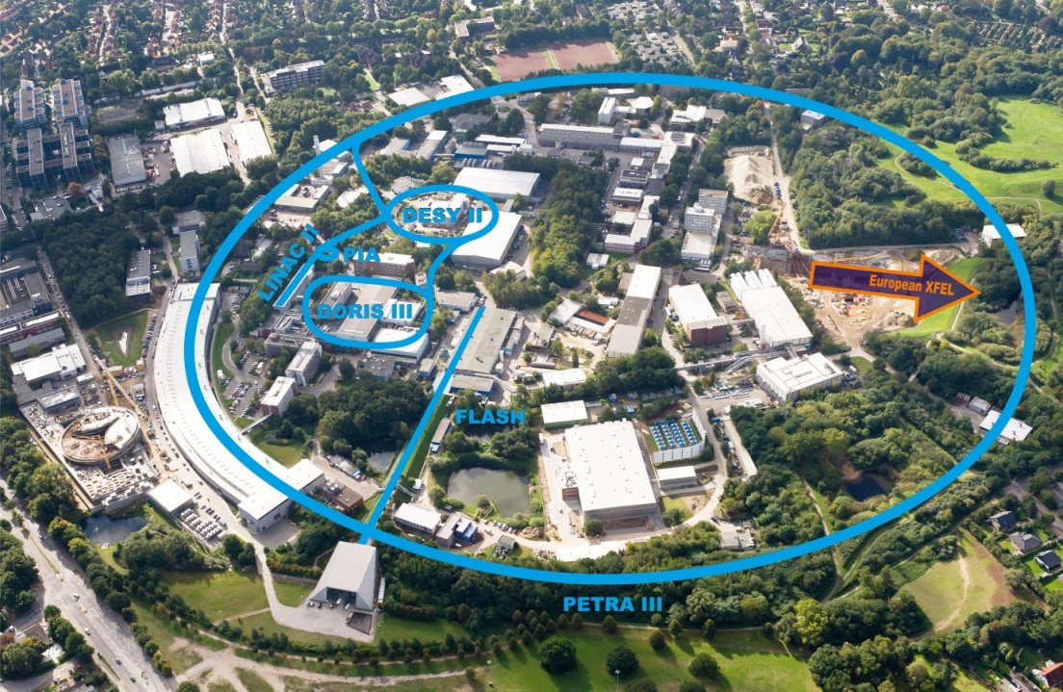
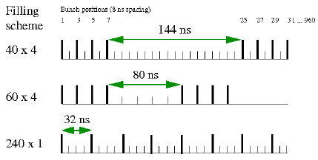
Time factor – pump and probe experiments
Electrons travel as bunches.
Typical Petra-III modes:
40
60
240
480
960
Single bunch is a charge carrying
electronic cloud
Bunches are separated by time
Bunches travel with relativistic velocity through
a complex magnetic array
Time separation between bunches can be used
for timing experiments:
Pump/Probe
Pump/Probe/Probe/Probe

Slide 27
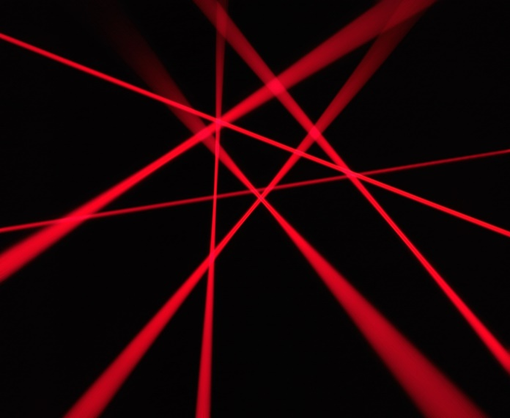
Future
X-ray lasers

Slide 28
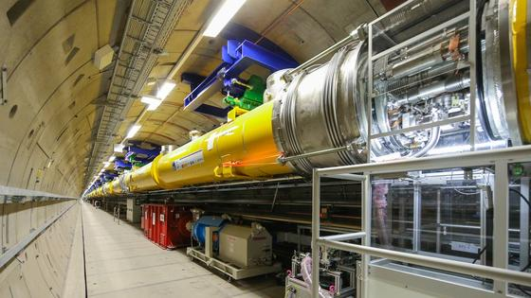
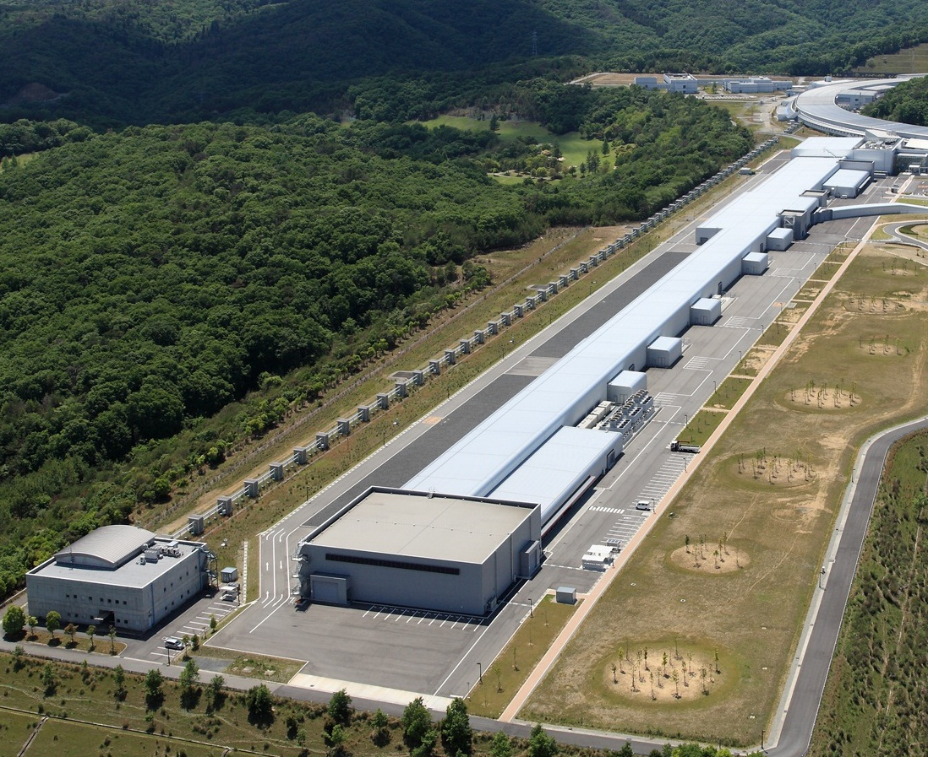
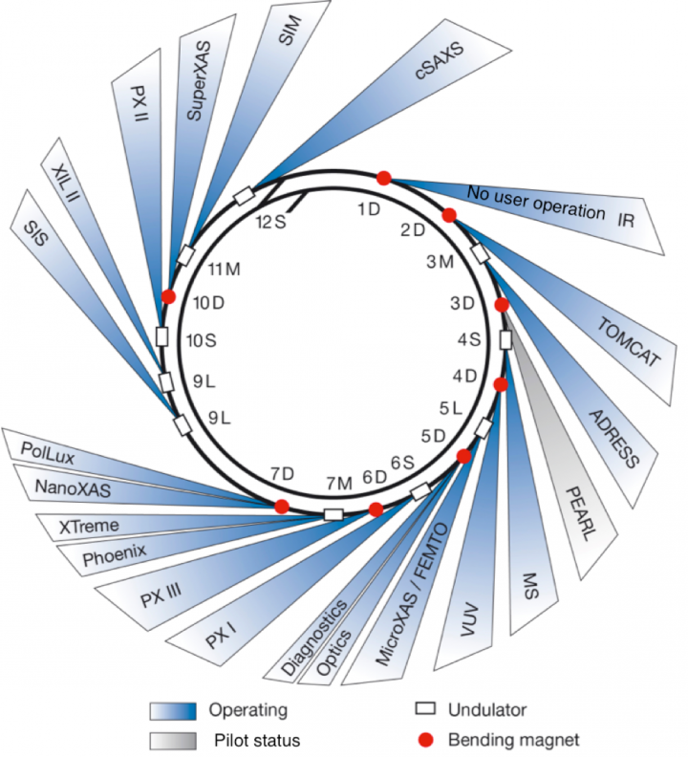
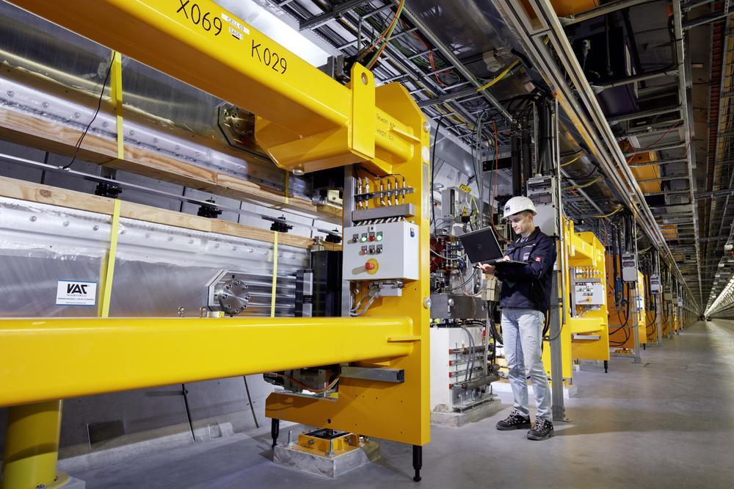
Future
Swiss Light source
tiny e-beam
accelerator
Huge accelerator
SACLA – RIKEN
Japan
Lost of magnetic structures

Slide 29
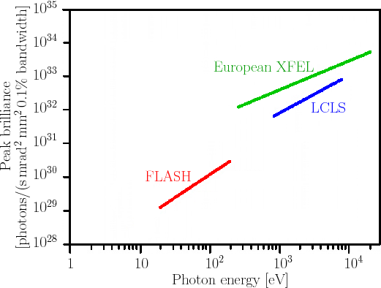
Accessible energy bandwidth
European XFEL
Largest X-ray free electron laser
27kHz repetition rate
0.05 to 4.7Å
Peak brilliance
5·10³³
(photons / s / mm² / mrad² / 0,1% bandwidth)
Suitable for high pressure research
A. Di Piazza et al. Rev.Mod.Phys. 84 (2012)

Slide 30
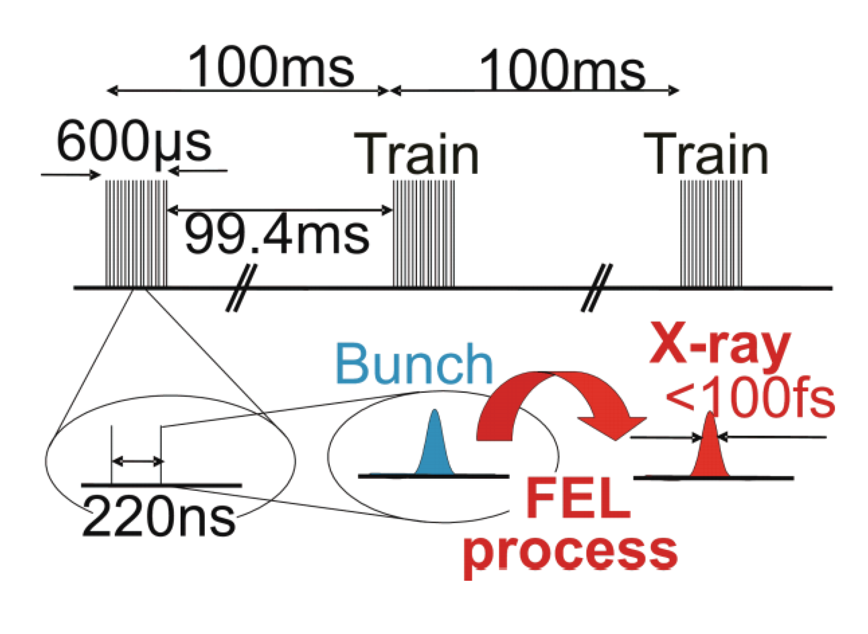
Extreme timescale resolution of XFELs

Slide 31

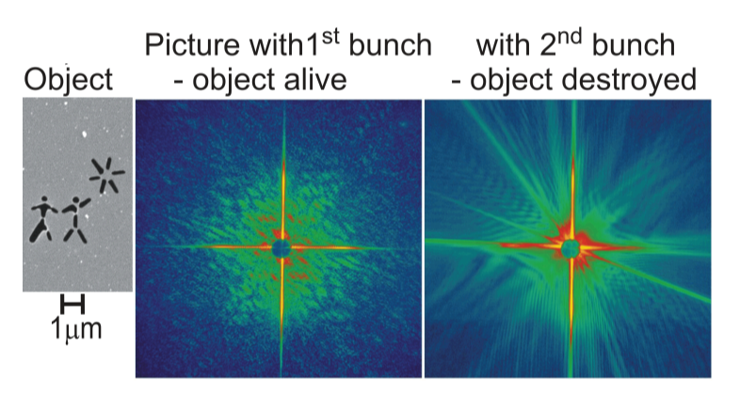
Extreme challenges of XFELs
Small angle X-ray diffraction

Slide 32
Things to take away
X-ray sources for high pressure
Lab. sources
Useful for compact environments (DACs)
Useless for large scale environments
Large scale sources
Useful for both: compact and large high pressure environments
Additionally offer data collection with enhanced time resolution

Slide 33
Things to take away
Important info for the source
Energy
Repetition rate
Energy bandwidth
Damage threshold
Brilliance
Emittance
Size

